Slide 1
COMM 2293:
Business Communications
Section F
Prof. Emily Ballantyne
February 5 2019– Persuasive Writing

Slide 2
Agenda
Persuasion
Assignment 3
  Audience analysis and purpose
Sentence Structure & Punctuation

Slide 3

Graphics Homework
DUE DATE: FRIDAY FEBRUARY 8th
Graphics

Slide 4
What is wrong with this persuasive message?
Please immediately stop selling cheese. Take all of the cheese off of your shelves, and stop supplying it. If a packaged food contains cheese, throw it out. By brokering in cheese, you are encouraging people to pollute their bodies and our shared environment. This has to stop, and it is your responsibility to stop it.
Cheese doesn’t taste good and it smells. A lot of people think it is gross, including me. So, to protect our bodies, let’s boycott it and stop selling it in Halifax.
The Food and Agriculture Organization of the United Nations (2006) suggests that 10.8 pounds of carbon dioxide are produced for every pound of cheese. That means that cheese is bad for the environment. If you care about nature, you should never eat or sell cheese.
Thank for your attention to this matter. I look forward seeing no evidence of cheese in your store by Monday.
Emily Ballantyne, Concerned Citizen
References
Food and Agriculture Organization of the United Nations (2006). “Livestock’s Long Shadow: Environmental Issues and Options”. Retrieved from http://www.fao.org/3/a-a0701e.pdf

Slide 5
Persuasion Strategy Basics
Problem
Solution

Slide 6

How do we persuade?

Slide 7
Persuasion
Change the audience’s attitude, behaviour or action toward an event, idea, object or person using language

Slide 8
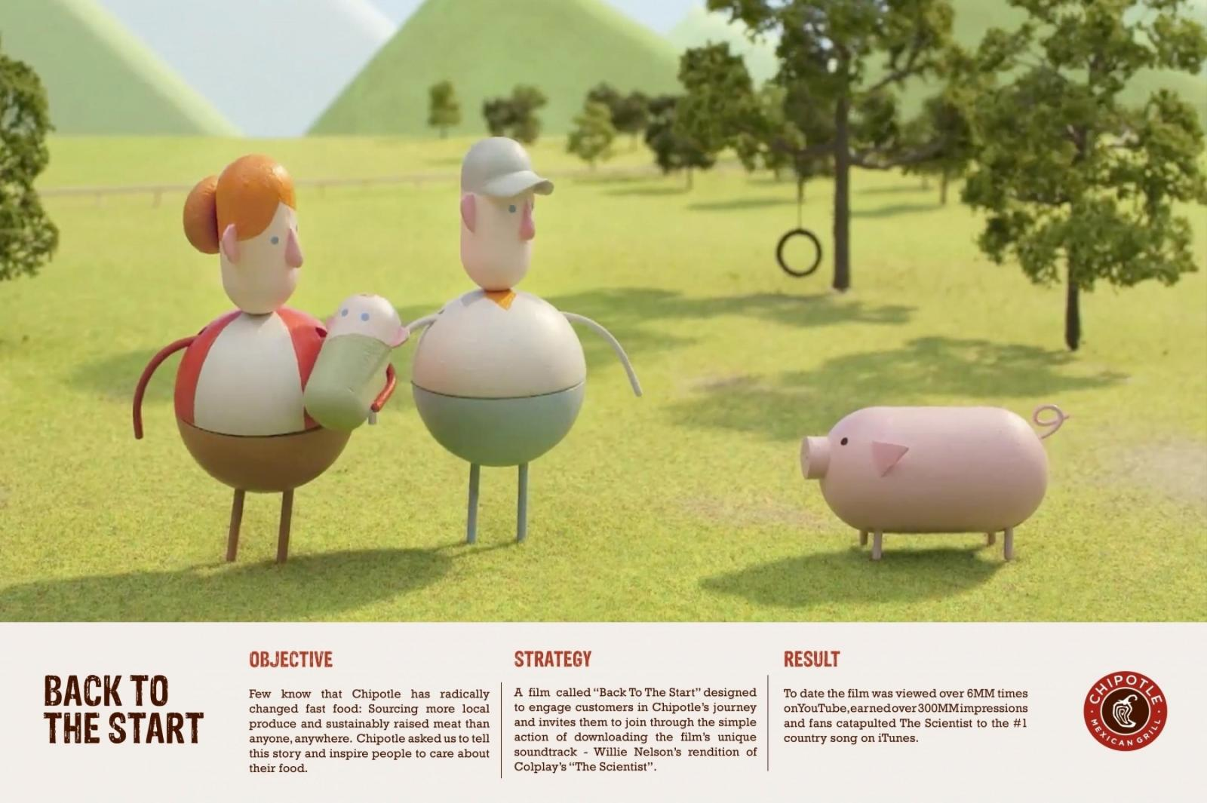
How does this video persuade?
https://www.youtube.com/watch?v=aMfSGt6rHos

Slide 9
Persuasion Analysis
What makes this message compelling?
What event, incident or problem is the message responding to?
How does the message create urgency?
What does it want us to change?
How would we make that change?

Slide 10
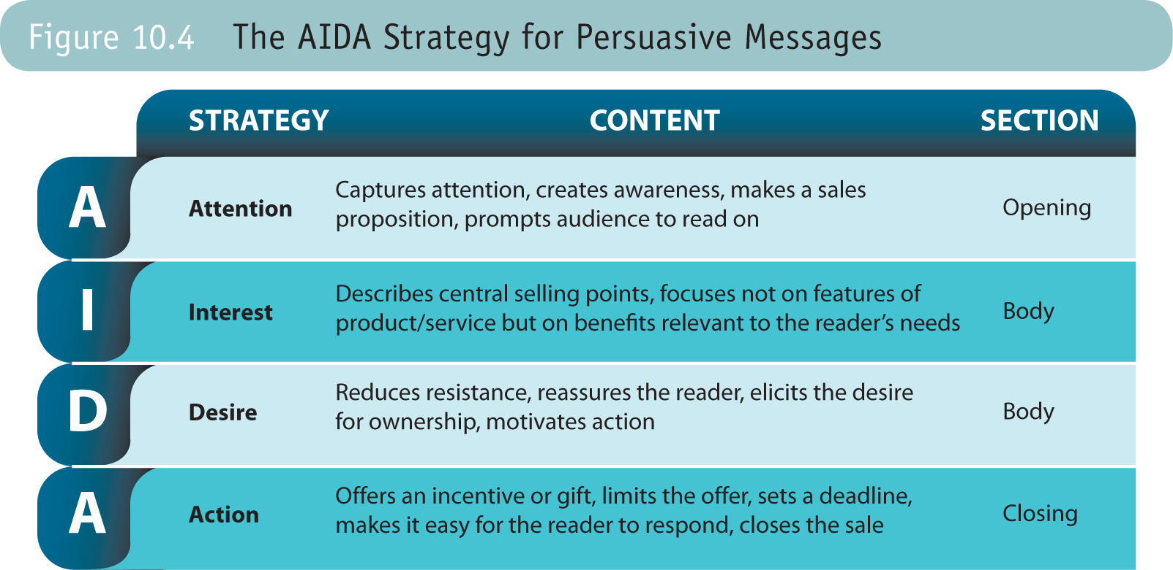
AIDA for Persuasion

Slide 11
Assignment 3
Halifax’s regional council recently voted to ban the distribution of all single-use plastic bags. The ban is unlikely to take effect in 2019. However, you would like your employer, Mr. Patel, to voluntarily stop distributing plastic bags now before the city bylaw comes into effect next year.
Your task:
Use the sources posted on Brightspace (as well as any other reliable sources you may find) to research the environmental impact and other potential effects of banning single-use plastic bags.
Using the AIDA strategy in Chapter 10, draft an indirect strategy memo to Mr. Patel persuading him to stop distributing single-use plastic bags at Harvest Grocery.

Slide 12

Audience Analysis
Arjun Patel, Owner and Operator
What might get his attention about this issue?
What benefits might come from getting rid of the bags?
What concerns will he have about eliminating bags?
This Photo by Unknown Author is licensed under CC BY-SA

Slide 13

Assignment 5 Purpose
This Photo by Unknown Author is licensed under CC BY-SA-NC

Slide 14
For next class, please bring one useful fact you could use to persuade Mr. Patel to stop distributing plastic bags. It can come from the research on Brightspace.

Slide 15
Sentence Structure
Subject
The who or what who performs the action. Can be a noun, pronoun or a gerund.
e.g. the professor, he, eating
Verb
The action or state of being. Can be a verb or a verb phrase.
e.g. talks, saw, may believe
Conjunction
Link the same types of words, including nouns, verbs and sentences
e.g. for, and, nor, but, or, yet, so
Link words in a sentence by showing the relationship between them
Preposition
e.g. at, on, above, over, through

Slide 16

Sentence Fragment
Sentence fragments are incomplete sentences.
Usually, one part of the sentence is missing (like the subject or the verb)
e.g. Even though this is tough.
This Photo by Unknown Author is licensed under CC BY

Slide 17
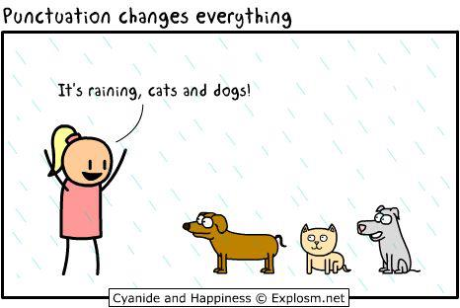
Comma Splice
A comma splice happens when two sentences are joined by a comma instead of a period.
e.g. The students pay attention, they work hard.
This Photo by Unknown Author is licensed under CC BY-SA-NC

Slide 18

Subject Verb Agreement
A subject-verb agreement problem happens when the number of subjects does not match the number of the verb.
e.g. The students and the professors is working hard.

Slide 19
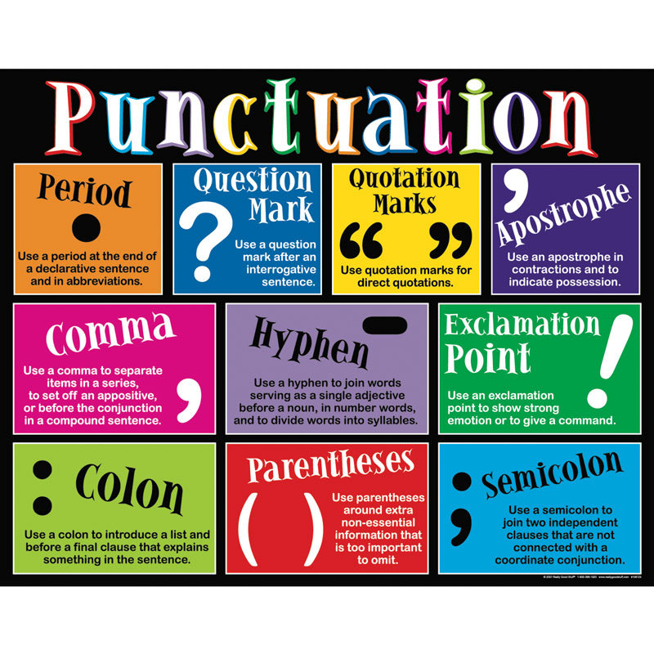
Punctuation
This Photo by Unknown Author is licensed under CC BY-SA-NC

Slide 20

Comma Rules
Put a comma before the conjunctions for, and, nor, but, or, yet, so when the conjunction joins two sentences.
e.g. I really like planning and writing, but they are a lot of work.
This Photo by Unknown Author is licensed under CC BY

Slide 21
Comma Rules
Put a comma after a word or group of words that come before the main subject and main verb.
e.g. At 4:00pm today, Professor Ballantyne started class.
This Photo by Unknown Author is licensed under CC BY

Slide 22
Comma Rules
Put a comma after each word in a series of three or more words joined by and or or.
e.g. In today’s class, we brainstormed, planned, and reviewed.
This Photo by Unknown Author is licensed under CC BY

Slide 23
Comma Rules
Put a comma between two (or more) adjectives if you can reverse the order of the words or put and between them
e.g. Hard-working, motivated students will learn the most.
This Photo by Unknown Author is licensed under CC BY

Slide 24
Comma Rules
Use commas to separate extra information from the rest of the sentence.
e.g. Emily Ballantyne, our professor, likes grammar lessons.
This Photo by Unknown Author is licensed under CC BY

Slide 25

Semicolon Rule
Use a semicolon only where you could also use a period
e.g. Be patient; we are almost through the rules.
This Photo by Unknown Author is licensed under CC BY

Slide 26

Colon Rule
Use a colon to introduce a list after using a signal word.
e.g. As you proofread, check for these common errors: sentence fragment, comma splice, and passive voice.
This Photo by Unknown Author is licensed under CC BY

Slide 27

Apostrophe Rules
Use an apostrophe to make a word possessive
e.g. The student’s grade is based on her performance.
This Photo by Unknown Author is licensed under CC BY-NC

Slide 28
Apostrophe Rules
Use an apostrophe to make a contraction
e.g. The class isn’t over yet.
This Photo by Unknown Author is licensed under CC BY-NC

Slide 29

Kahoot!
Notes:
Program
Year
Reason for choosing this class
Important feature of good writing
Biggest writing problem

Slide 30
For next class, please bring one useful fact you could use to persuade Mr. Patel to stop distributing plastic bags. It can come from the research on Brightspace.

Slide 31
For Thursday
Persuasion 2: AIDA
Read: Chapter 5: 117-118;
Chapter 10: 253-259;
Chapter 11: 290-294;
Coursepack: 10
Review: Assignment 3 Memo
Write: Graphics Homework; 1useful fact for AIDA message

